Slide 1


2017/18 End of Season Player Performance Review
Data Science Group
Ashish, Christian, Giacomo, Ollie, Viktor
{firstname}@inter.it

Slide 2

Motivation
Team Performance group highlighted overall strengths and weaknesses.
The Player Performance group takes a data-driven approach to:
Identify high and poor performing players within the Inter squad;
Identify transfer targets in all positions that enables Inter to:
Mitigate key asset losses;
Strengthen positions of vulnerability;
Add depth to the squad following Champions League qualification.
Key actions last year:
Fended off €45m interest from Manchester United for Perišić;
Added Škriniar at CB for €34m and Dalbert at LB for €21m;
One-year loan for Cancelo at RB, with option to buy not triggered.
Notes:
https://sempreinter.com/2018/06/12/sempreinter-coms-player-of-the-year-for-the-2017-2018-season-is/

Slide 3
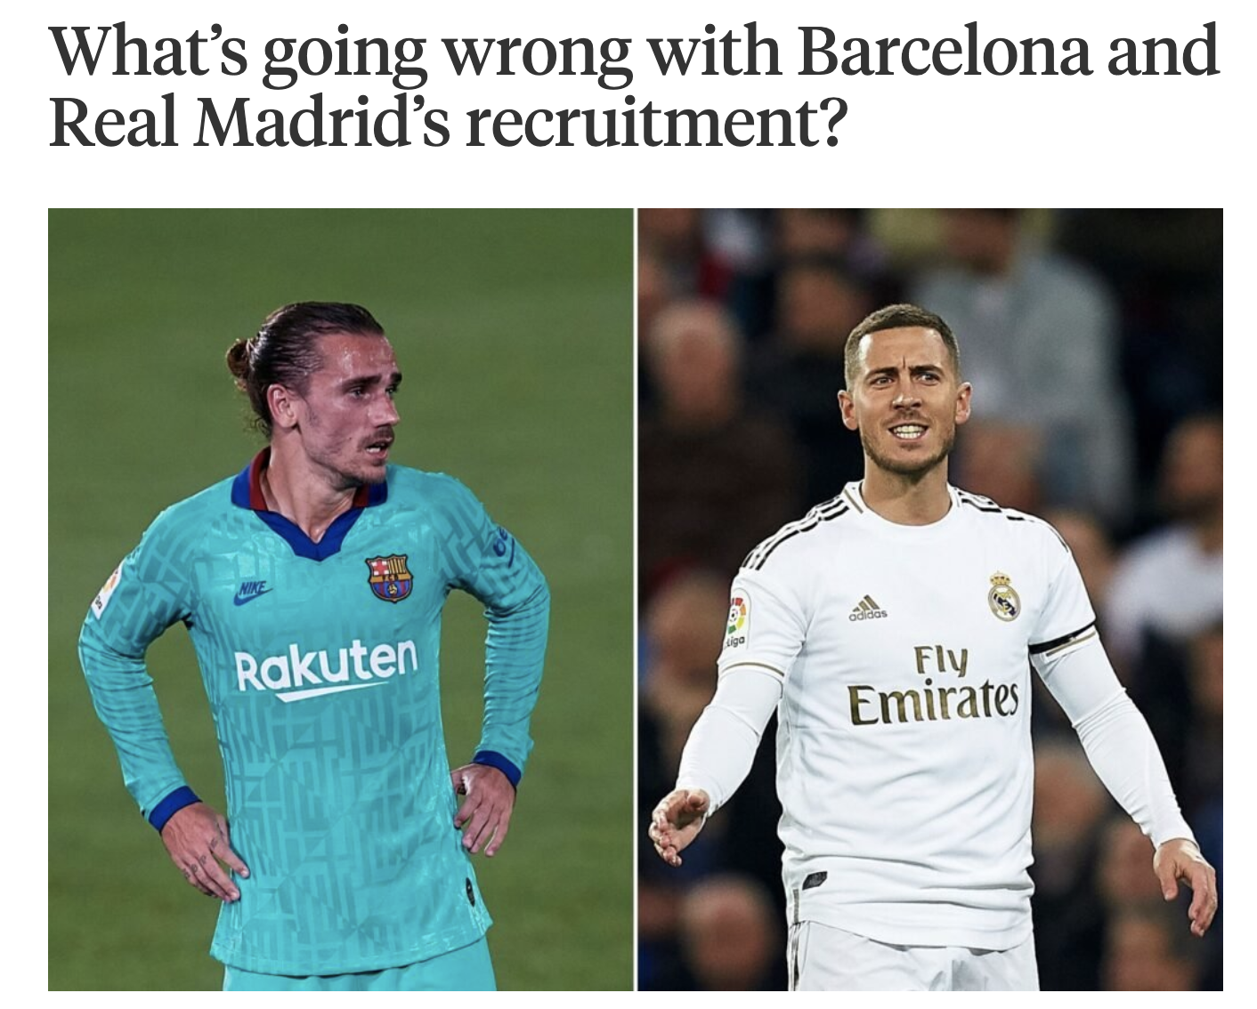
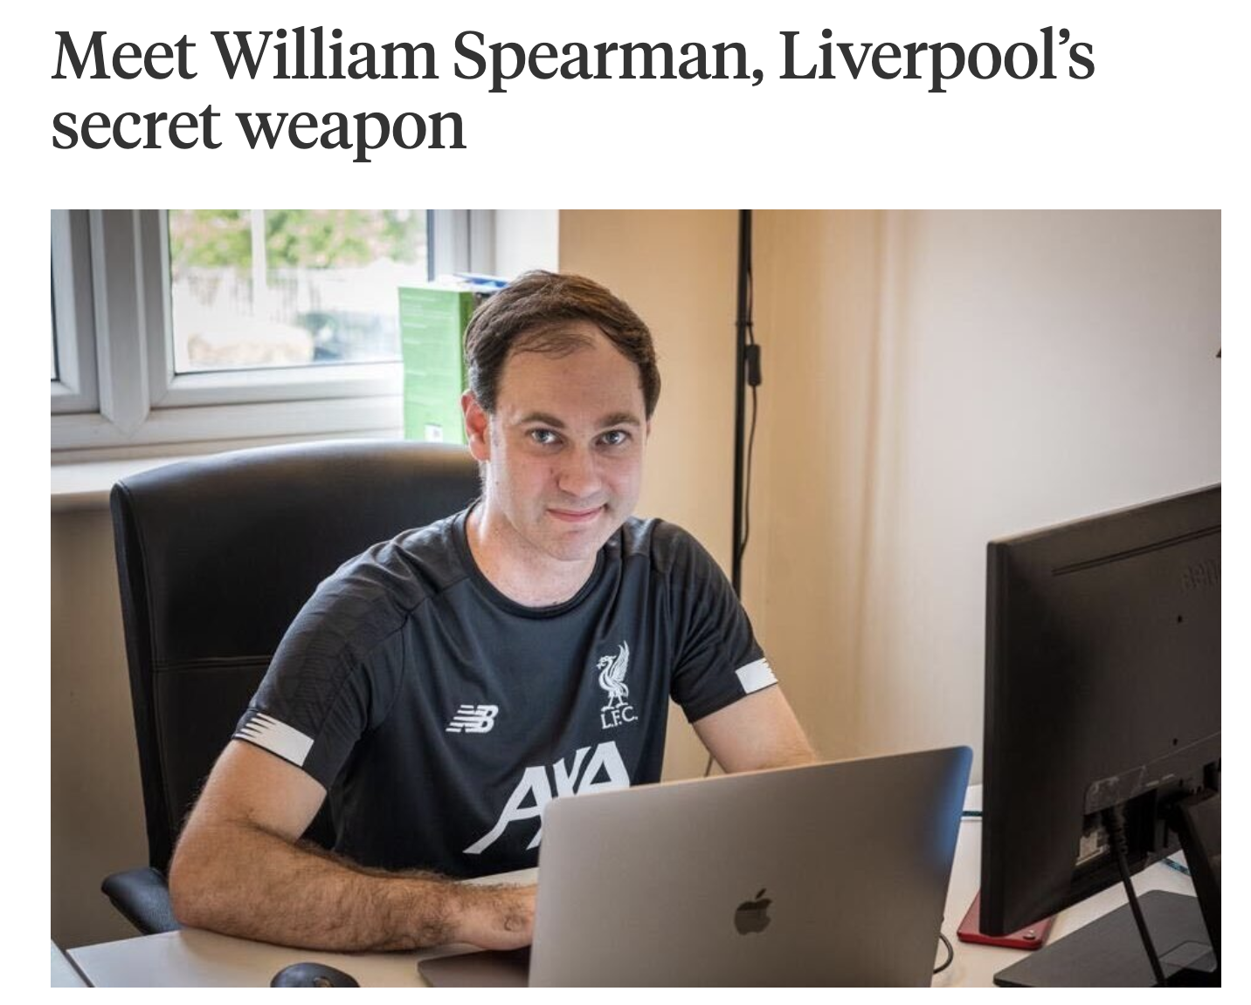
Competition: on and off the pitch
Since 2014, Barcelona’s net spend of €450m is 3x that of Champions League winners Liverpool.
Hard to find competitive edge in data-driven football recruitment: complex invasion game with game-changing actions happening off the ball.
Combine Inter KPIs that suit our style of play with a systematic framework to value player actions.
Expected threat (xT) provides an intuitive way of valuing on-the-ball actions that move the game into a state with increased goal likelihood.
Notes:
State -> Markov Model of possession sequences
As the ball is moving with a position sequence, it’s transitioning between transient states across the pitch.
Reach an absorbing state if you either score or lose possession.

Slide 4
Expected Threat (xT)
Why xT?
Rewards individual player actions in buildup play – not just goals / assists.
Rewards actions independent of the end outcome of the possession (each action is assigned a score in isolation).
Rewards moving the ball not just into high-xG shooting positions, but also into threatening positions that can in turn lead to high-xG shooting positions with high likelihood.
How it works:
Assign xT values to pitch zones that reflect threat (in terms of goals) of either successfully shooting or successfully moving at that location.
Value action of a player moving the ball by computing the difference in xT between the start and end locations.
Notes:
Move = dribble, cross, pass.

Slide 5
From Club Performance to Players
We focus our threat down both flanks and create chances through crosses
Opponents deviate from their usual strategy to target our left back

Slide 6
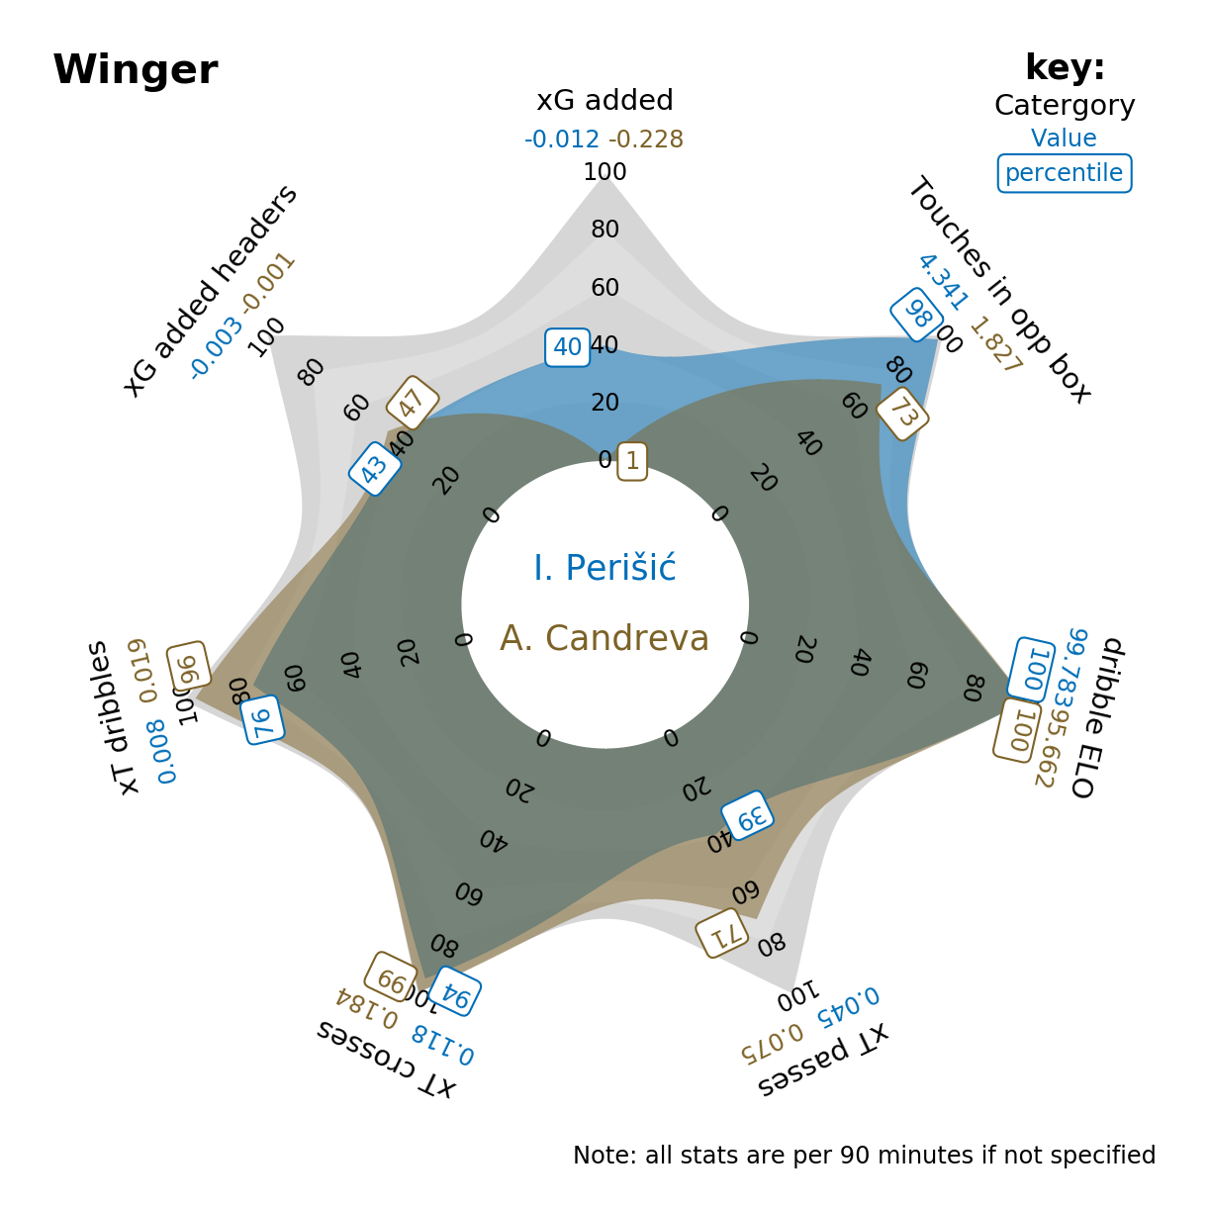
World class dribbling & crossing
xT:
Dribbling;
Crossing;
Passing.
ELO (a chess match of attack Vs defence):
Dribbling.
xG:
xG Added (Shots);
xG Added (Headers).
Traditional:
Number of touches in opponent’s area.

Slide 7
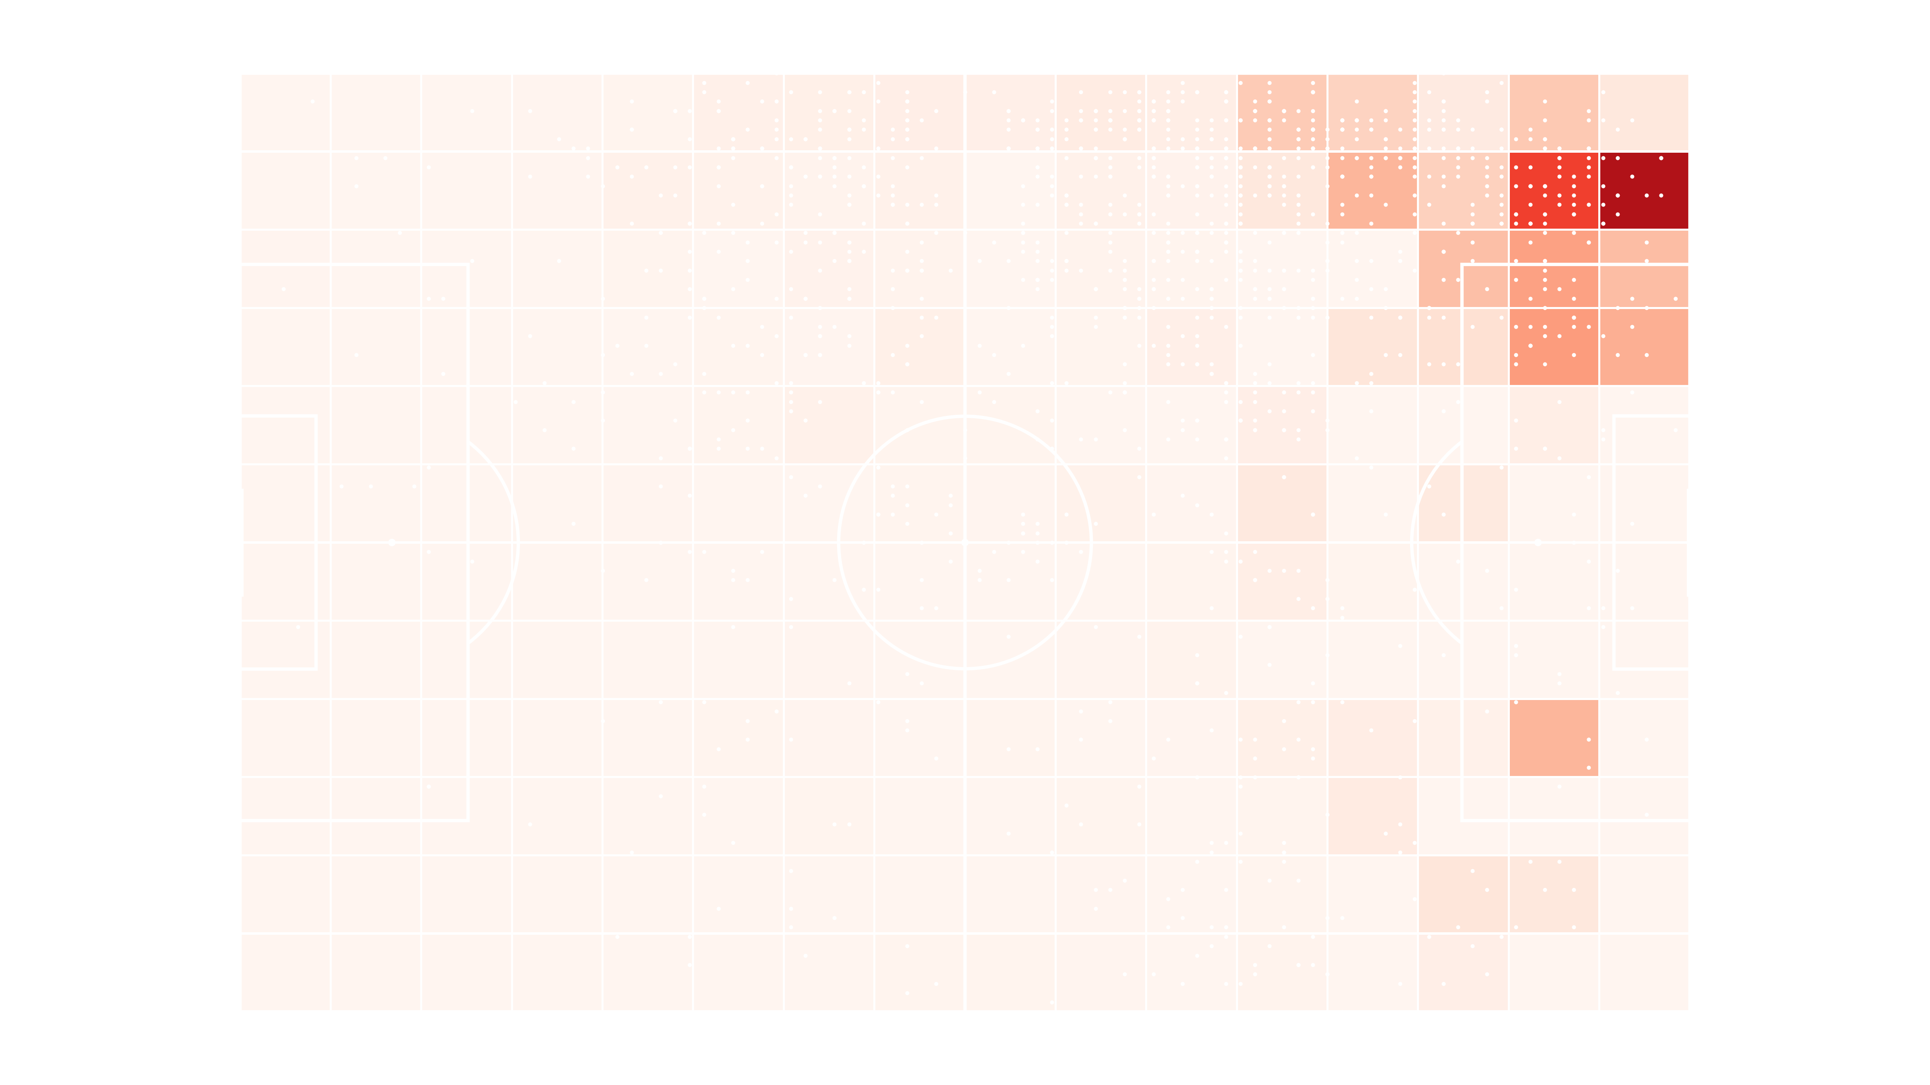
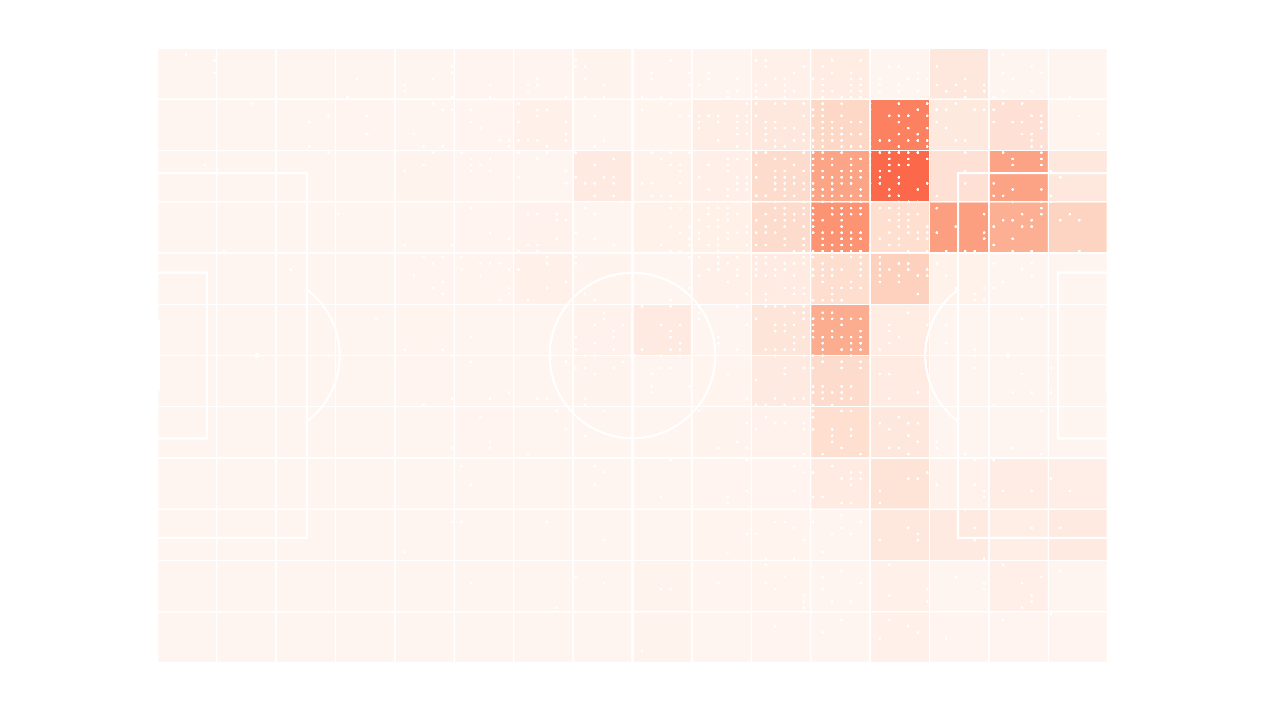
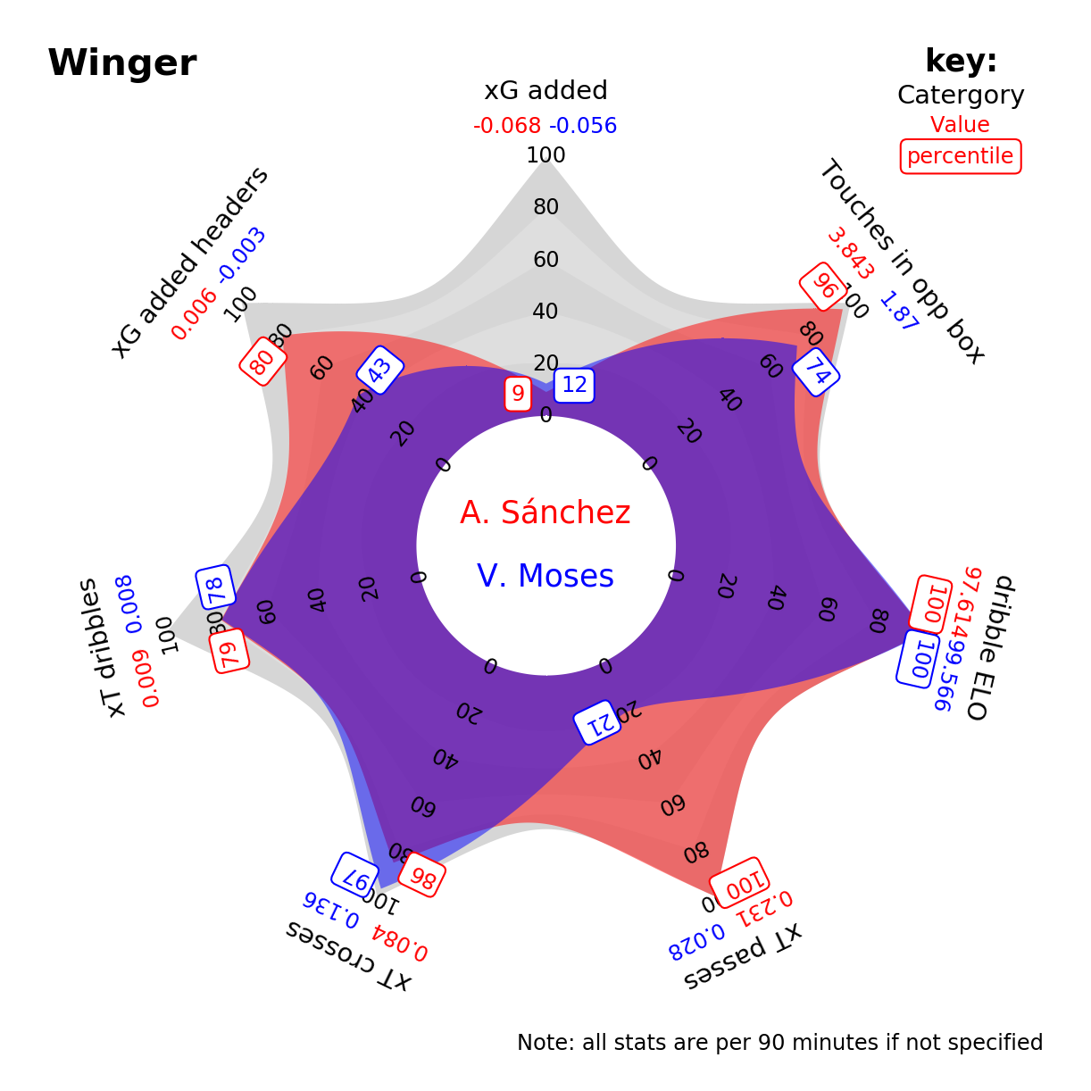
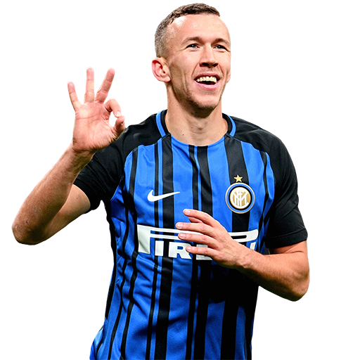
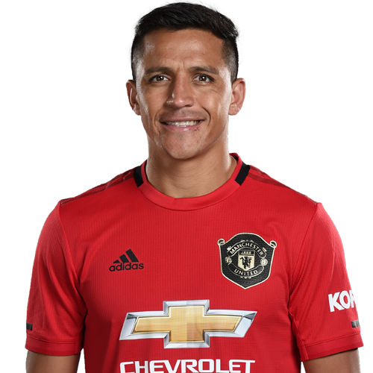
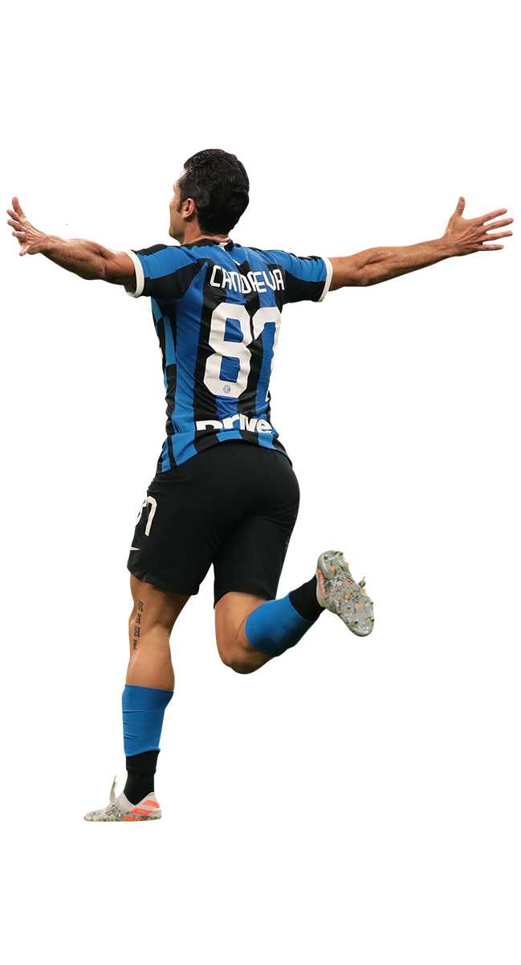
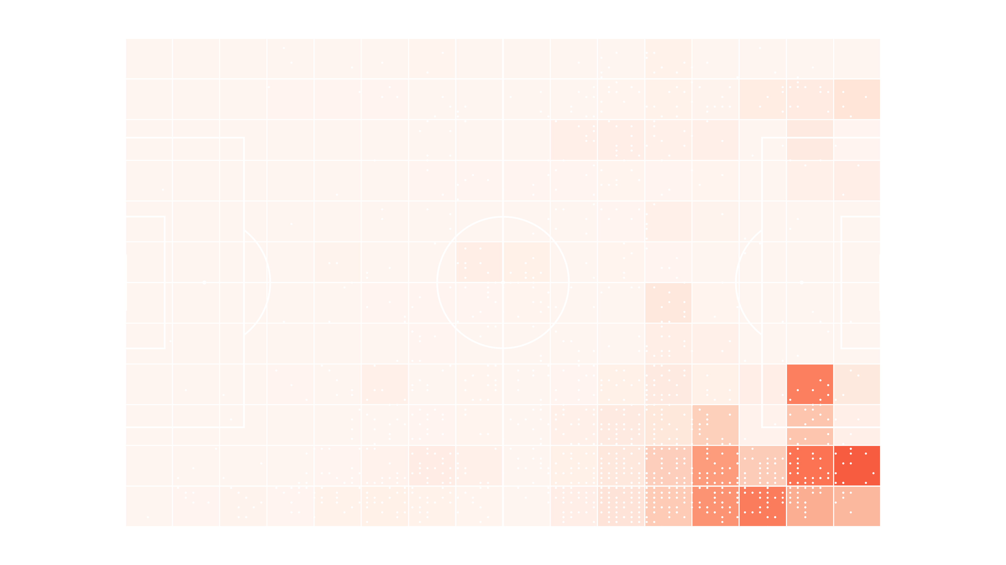
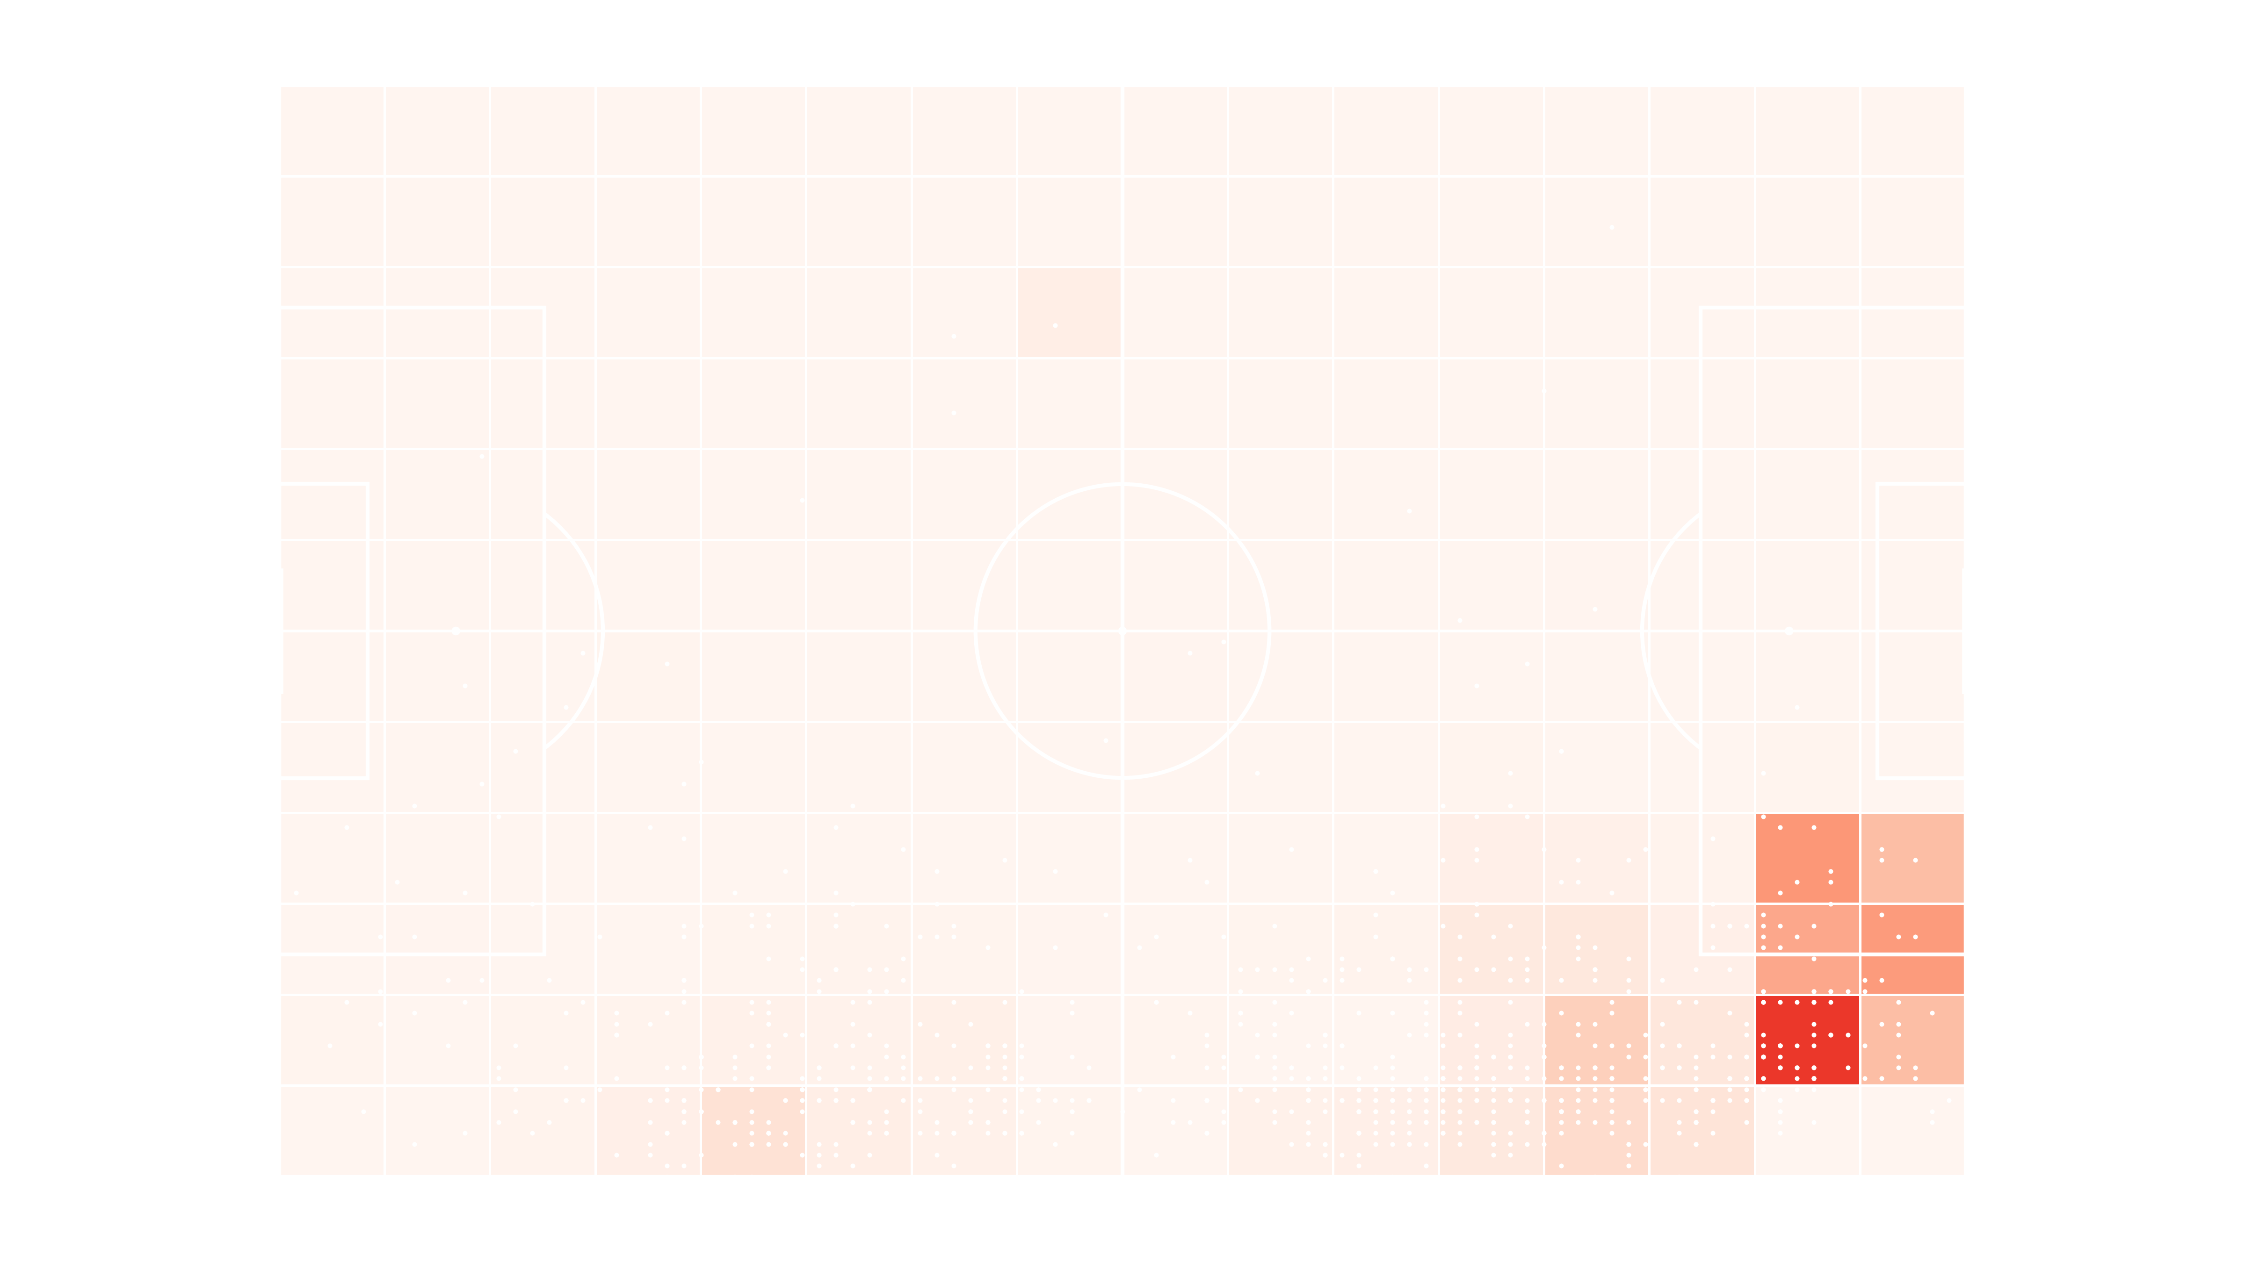
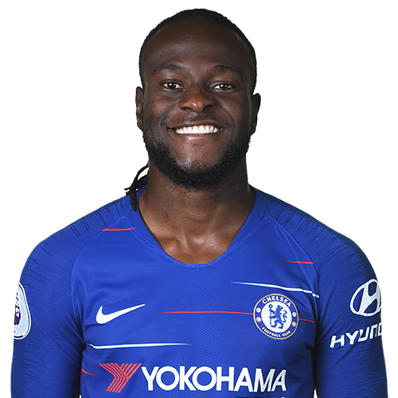
Perišić replacements & squad depth

Slide 8
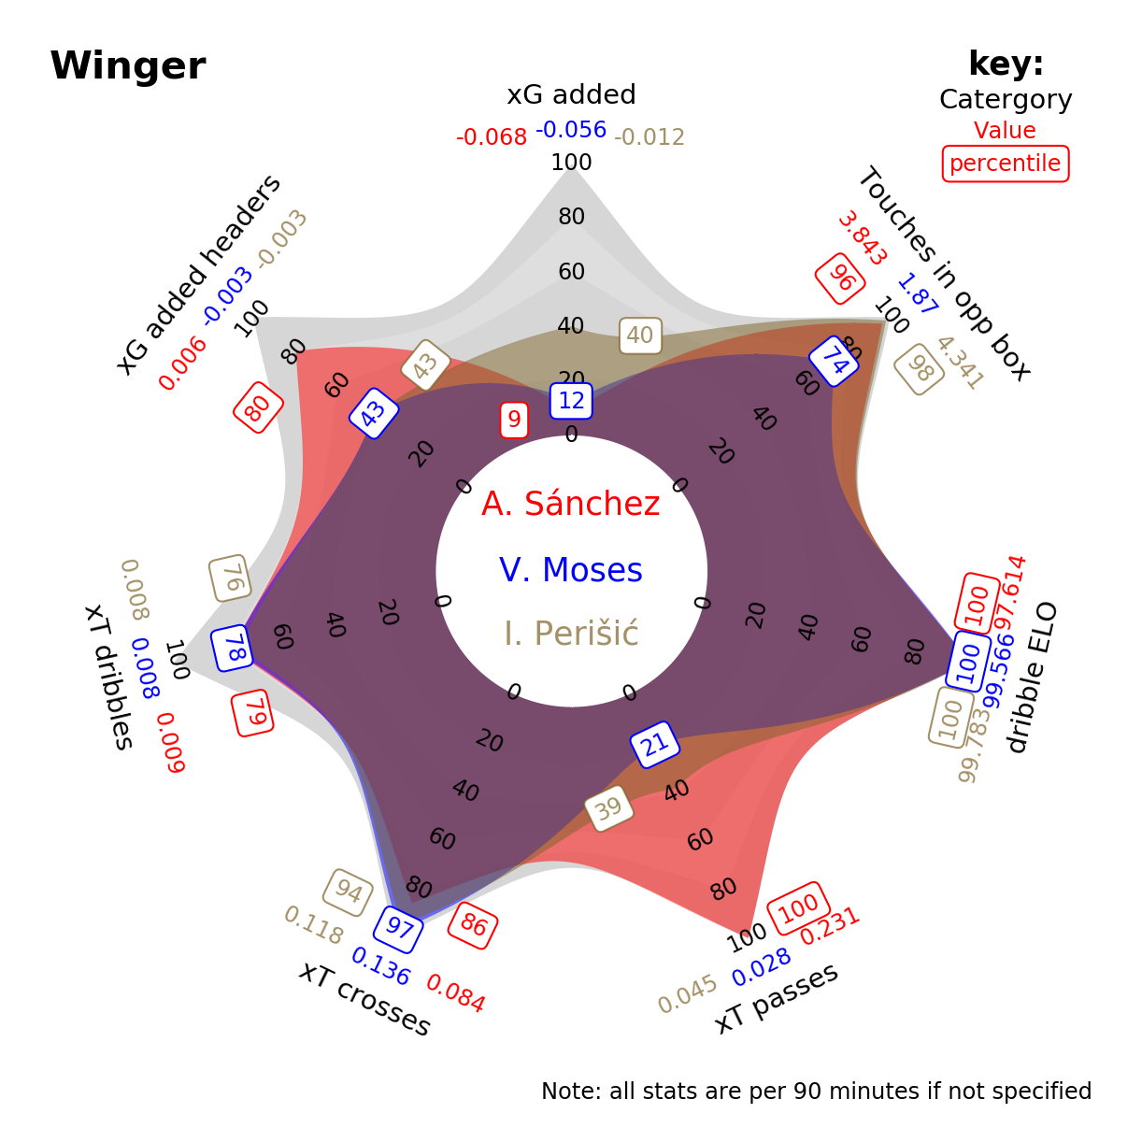
Perišić replacements & squad depth

Slide 9
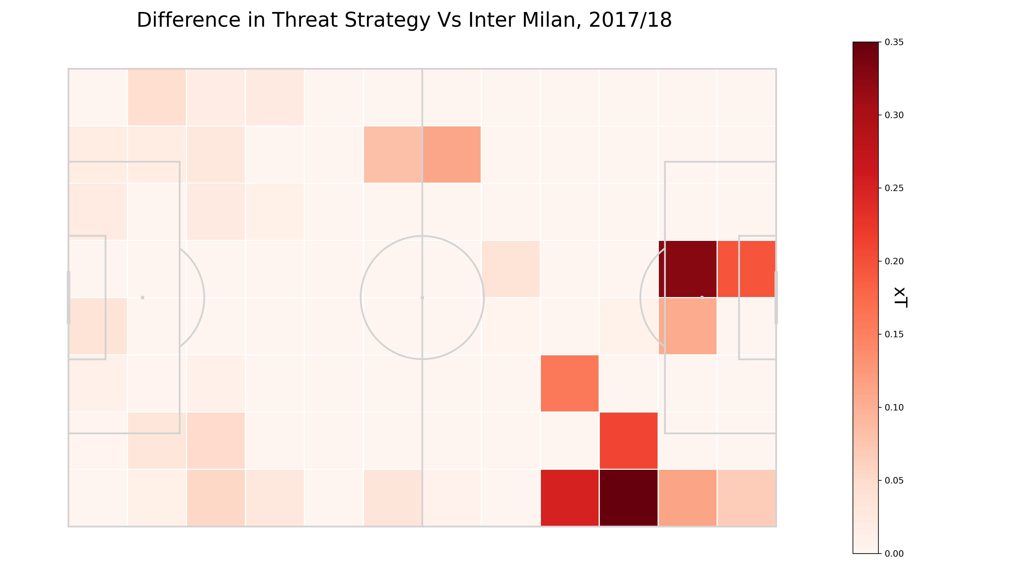
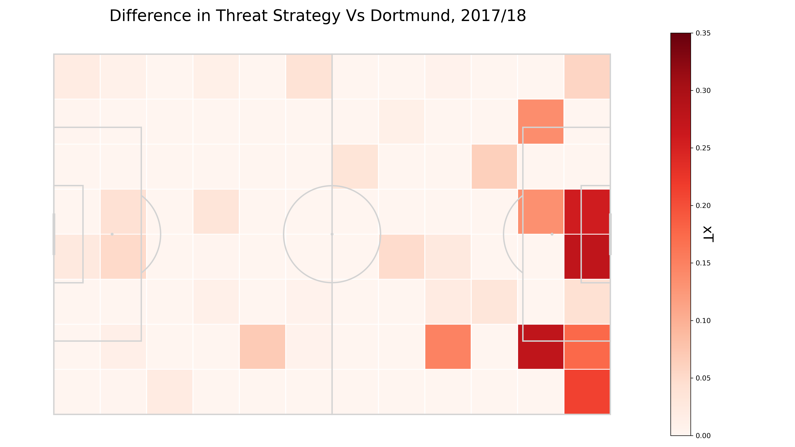

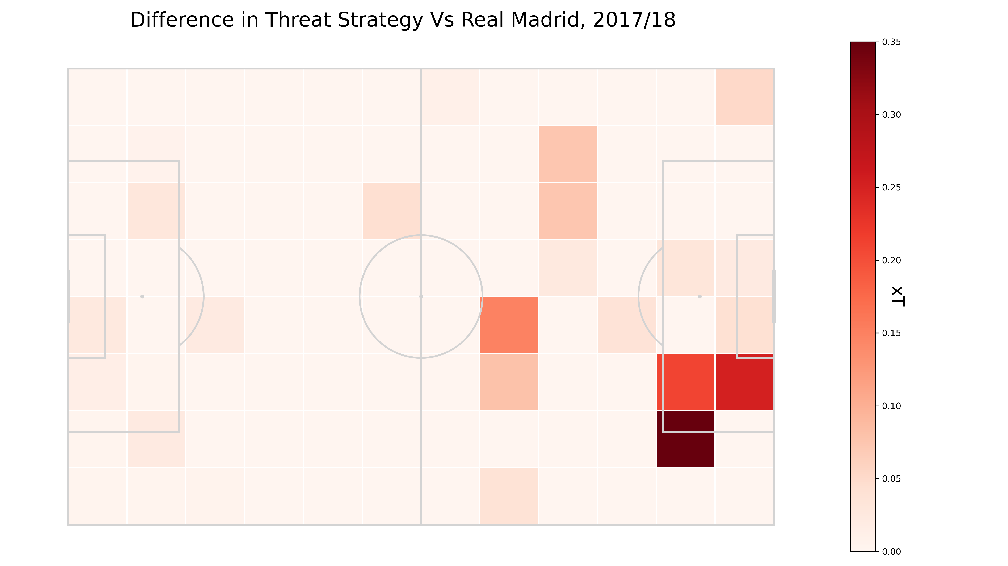

Opponent’s Delta xT strategy Vs Inter
As Lodve (and Maldini) says:
“If I have to make a tackle, I’ve already made a mistake”
On-the-ball events data are blind to off-the-ball context.
Indirectly observe opponent’s Delta xT strategy:
Calculate average opponent threat per zone ex. Inter;
Calculate average opponent threat per zone Vs Inter;
Sum the threat deltas for all opponents.
D’Ambrosio preferred to Nagatomo, Dalbert, Santon at left back, despite being a right-footed right back.

Slide 10
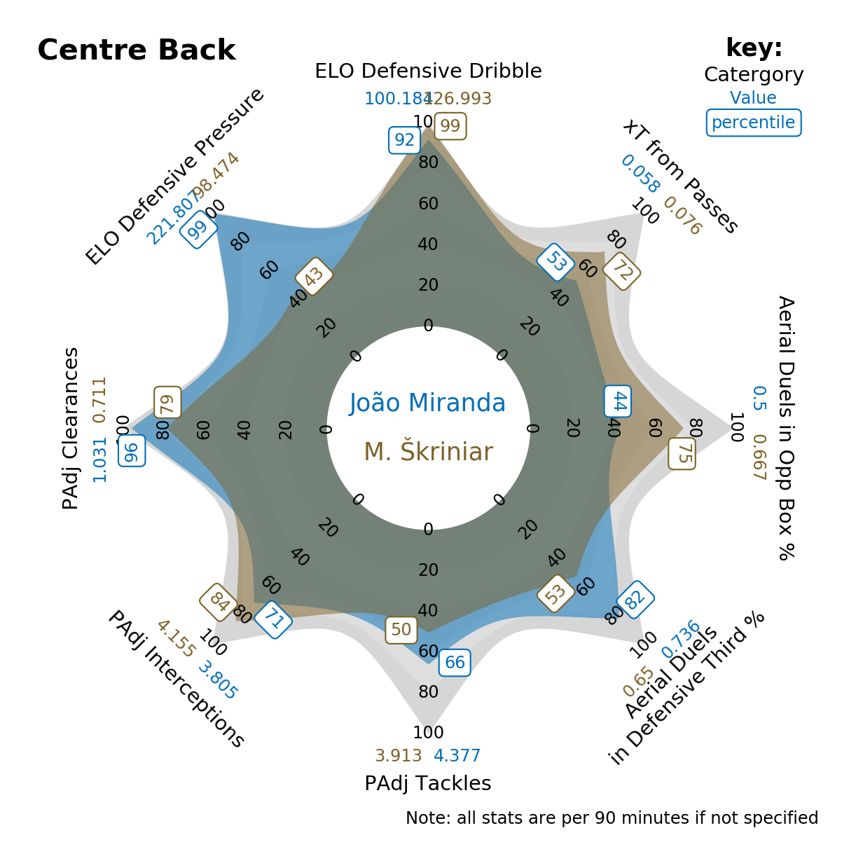
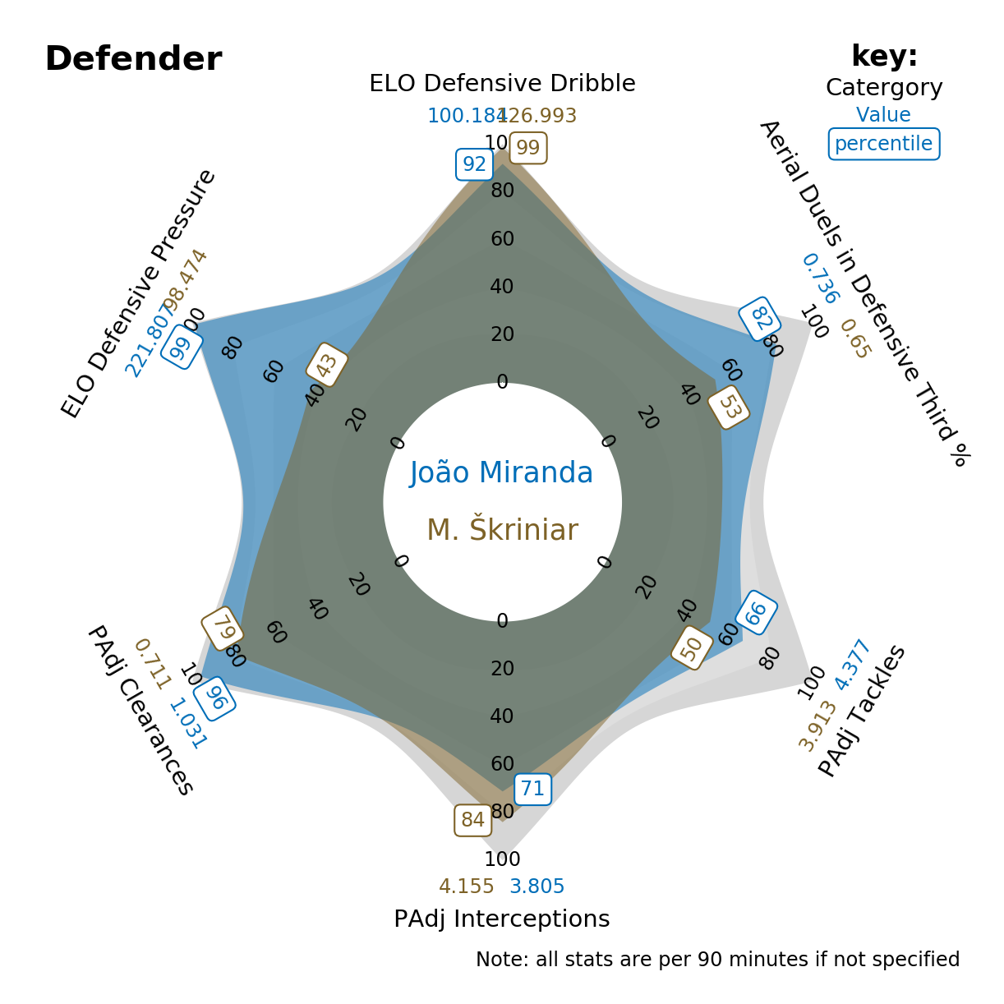
Defenders that can (and can’t) defend
Both centre halves are exceptional one-on-one defenders Vs dribble.
Complement each other’s weaknesses:
Škriniar takes chances to intercept the ball but has ability to recover if his initial pressure fails.
Miranda aerially dominant at the back, the master of applying physical pressure and clearing rather than diving in.
Škriniar also offers offensive threat – both on the ground and in the air.
An Artist-Tank partnership.
Notes:
Throwback to the Walter Samuel & Lucio partnership under Treble winning Mourinho.

Slide 11
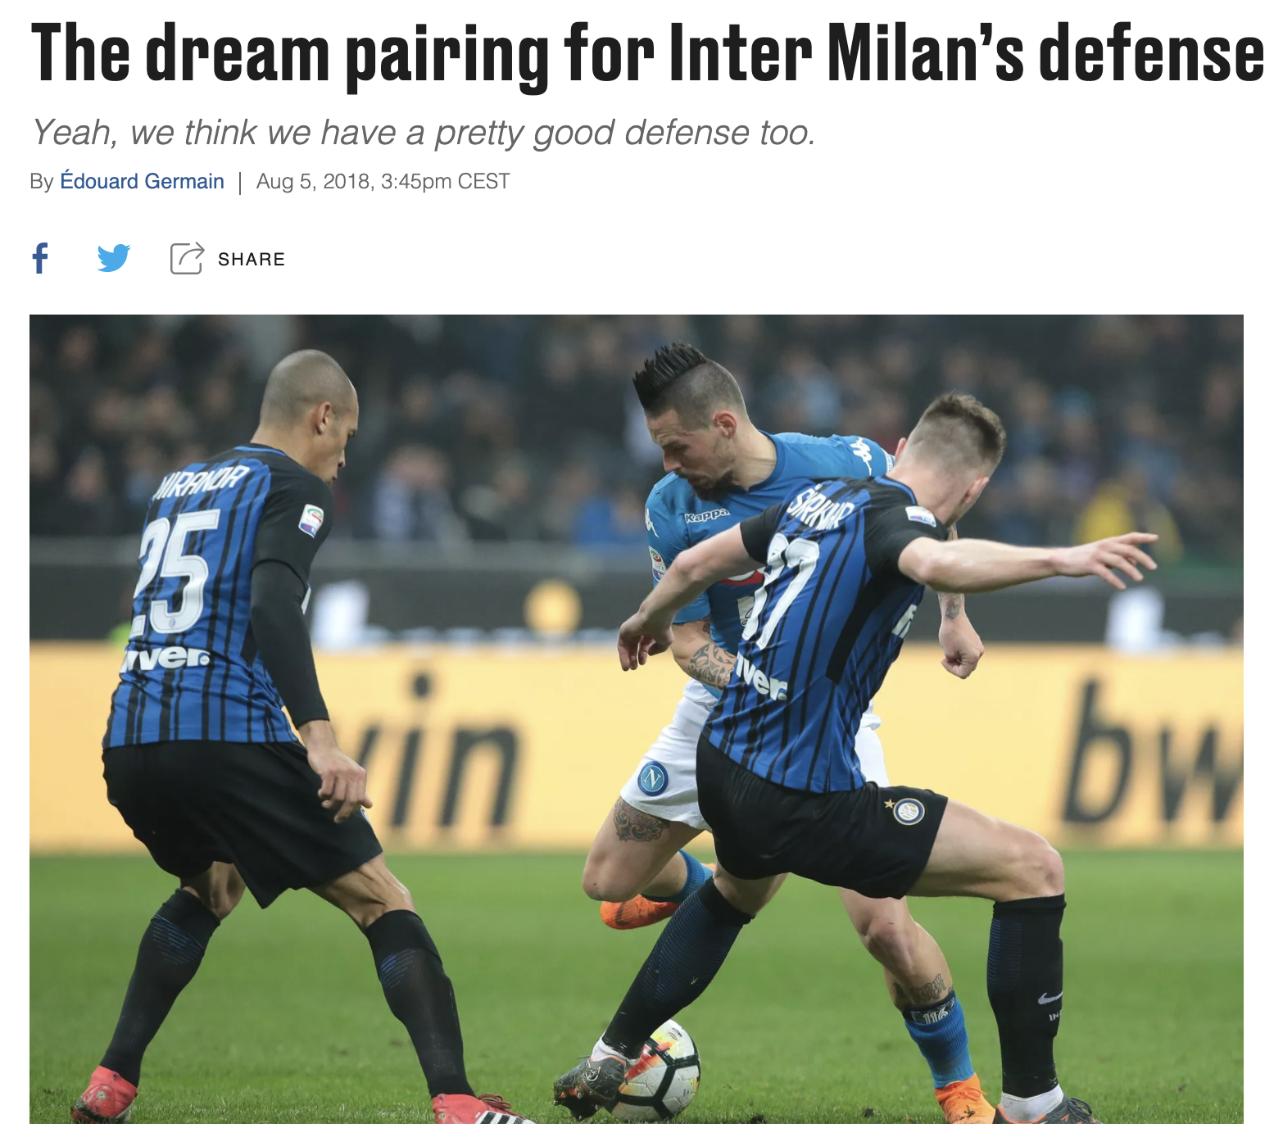
Defenders that can (and can’t) defend
Notes:
https://www.serpentsofmadonnina.com/2018/8/5/17634110/the-dream-pairing-for-inter-milans-defense-milan-skriniar-joao-miranda-stefan-de-vrij

Slide 12
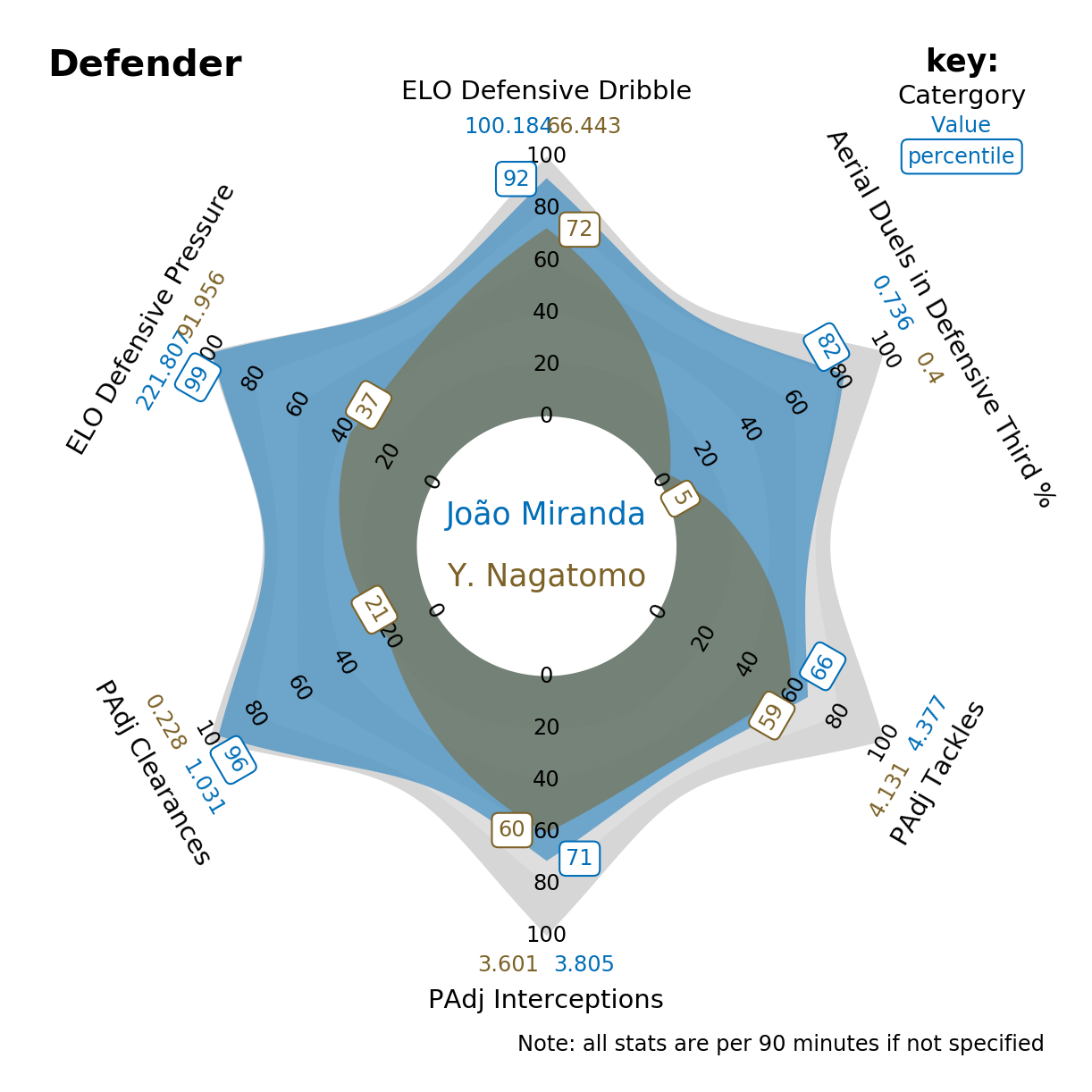
Defenders that can (and can’t) defend

Slide 13
Links to Fitness Group
On-the-ball events only provide half the story: direct off-the-ball context
Link technical player attributes with physical: more CL games, more energy
Two years on… Are we happy with our left backs?

Slide 14
Next steps
Look for left and right back first team replacement candidates
Expand the range of metrics to cover a broader range of positions
Start with a realistic budget and simulate adding strength in depth in collaboration with the Team and Fitness groups (using Transfermarkt values)

